Slide 1

PRACTICAL
OBJECT-ORIENTED
DESIGN WITH UML
2e
Chapter 11:
Component Diagrams

Slide 2
Component Diagrams
The object model describes the logical structure of programs
Their physical structure is also important
  source files
  package structure
  archive and library files
UML includes notation that relates to physical as well as logical structures

Slide 3

Dependencies
Associations, generalization and realization have specific and narrow meanings
Other relationships between model elements are shown as dependencies
  usually with a stereotype to indicate meaning
  eg the C++ ‘friend’ relationship between classes

Slide 4
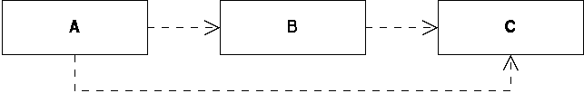
Dependency Semantics
Every dependency implies that one element needs to make use of another in some way
  unlabelled dependencies simply mean ‘uses’
  usage dependencies are transitive

Slide 5

Components
Components are the basic element of physical design
Usually taken to be
  a some physical entity
  which can be deployed as part of a system
  for example, a Java class file

Slide 6


Artefacts
Other physical elements are not deployable
  for example, source code
UML models these as artefacts
Components are often used as well

Slide 7

Components and Artefacts
The distinction is rather unclear
  class files could be viewed as artefacts
  and components as more abstract things implemented by an artefact
  the component is dependent on the class file

Slide 8

Source Code
We can illustrate the relationship between
  design-level classes
  and their source code implementations
  the source code implements the class, and so is dependent on it

Slide 9


Importing source code
In Java, source files can import packages
In C++, one source file can include another

Slide 10

Compilation
Compilation introduces a dependency between object and source code

Slide 11
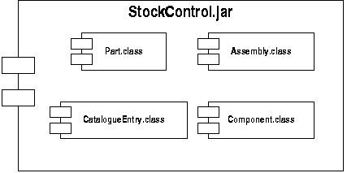
Archive Files and Libraries
Code libraries, or Java JAR files can be deployed as part of a system
  they are naturally modelled as components
  they contain other components

Slide 12
Compilation Dependencies
Component diagrams are often used to document compilation dependencies
  when a source file is changed, we need to know what parts of the system need to be recompiled
General principles
  keep dependencies to a minimum
  try to avoid dependency cycles where classes cannot be compiled independently

Slide 13
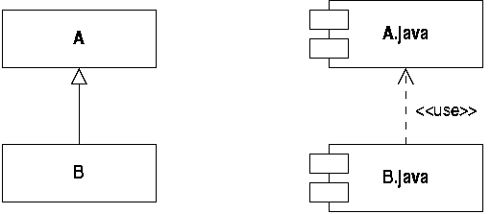
Generalization Dependency
Subclasses have a compilation dependency on their superclass
  if the superclass is changed, you will have to recompile the subclasses

Slide 14
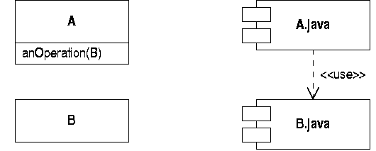
Using in the Interface
If class A refers to class B in its interface, there is a compilation dependency

Slide 15
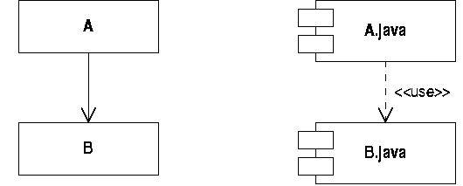
Using in the Implementation
If class A uses class B in its implementation, there is a compilation dependency
  this arises if an association links A to B

Slide 16
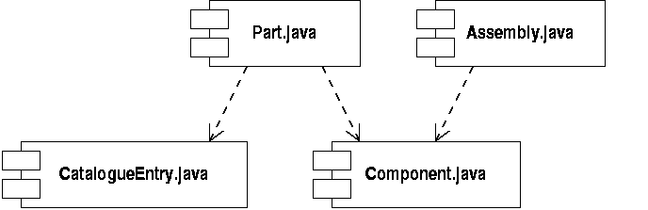
Dependency Graphs
By applying these rules we can build a graph showing all the dependencies for a program
  eg for the stock control program

Slide 17
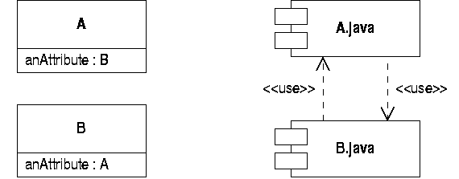
Physical Hierarchy
This graph is hierarchical
  the system can be built and tested ‘bottom-up’
Avoid dependency cycles where possible

Slide 18

Components and Interfaces
Components can support interfaces
  eg a Java class may realize an interface
This can be shown in UML by combining notation seen previously

